Slide 1
Table of Contents
Transposition Ciphers
Rail fence
Polyalphabetic Ciphers
Vigenère Cipher
Alberti's Disk
Polygraphic Ciphers
Playfair Cipher
Hieroglyphics and Steganography
Other Ciphers

Slide 2

Transposition Ciphers
Rail fence: The rail fence cipher walks up and down “rails” to scramble letters. This key for this cipher is the number of rails. For example, we’ll replace spaces with asterisks and let our number of “rails” be 3 (n=3):
ASCII : Sample text
Rail fence : Sleapetxm*t
Grid : S l e
a p e t x
m * t
https://www.boxentriq.com/code-breaking/rail-fence-cipher

Slide 3
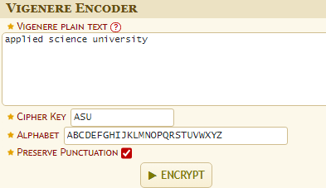
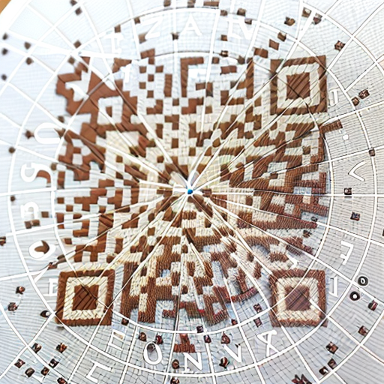
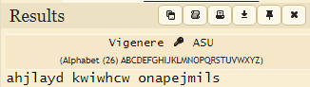
Polyalphabetic Ciphers
Vigenère Cipher: this is a polyalphabetic substitution cipher. It uses a keyword to determine the shifting of letters in the alphabet. It was considered very secure for its time.
https://www.dcode.fr/vigenere-cipher

Slide 4
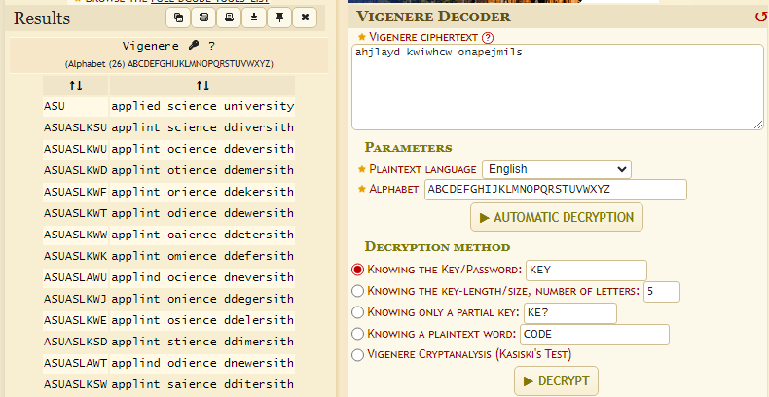
Polyalphabetic Ciphers
Vigenère Cipher:

Slide 5
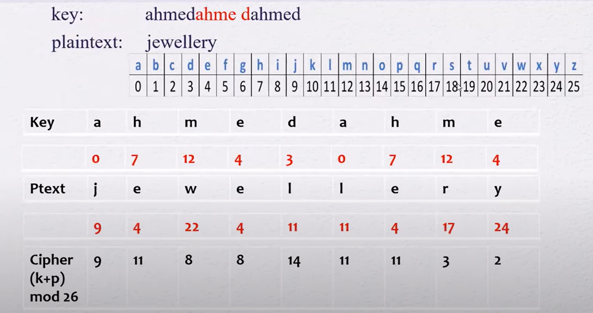

Slide 6
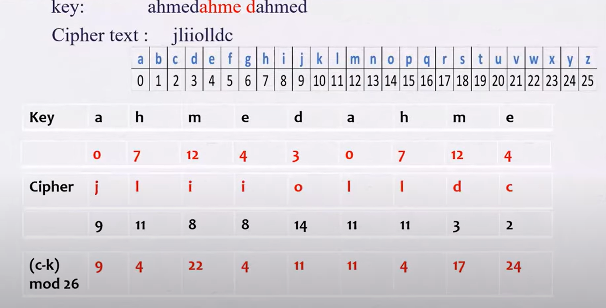

Slide 7
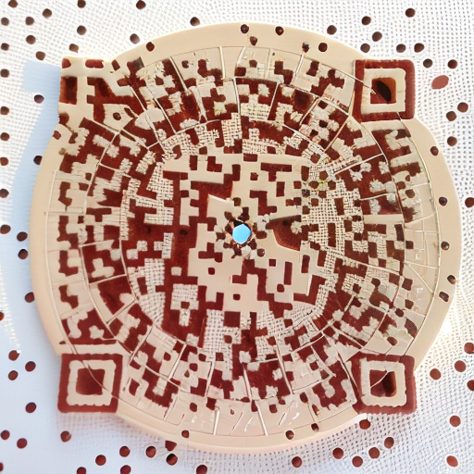
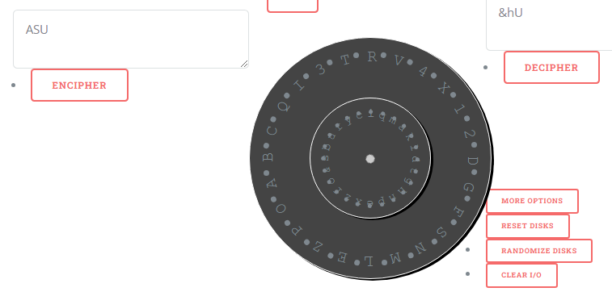
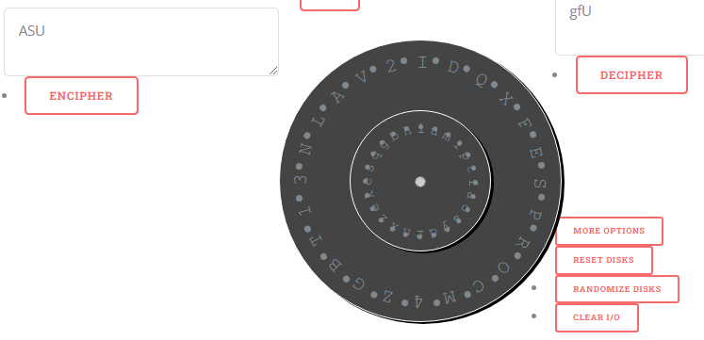
Polyalphabetic Ciphers
https://goto.pachanka.org/crypto/alberti-cipher-disk/
Alberti's Disk: this device had two rotating disks, one with the plaintext alphabet and the other with a mixed alphabet. By aligning the two disks, different substitutions could be used for each letter.

Slide 8

Polygraphic Ciphers
Playfair Cipher: the Playfair Cipher encrypts pairs of letters instead of individual letters. It uses a 5x5 grid of letters and a set of rules for generating the ciphertext.
https://www.dcode.fr/playfair-cipher

Slide 9
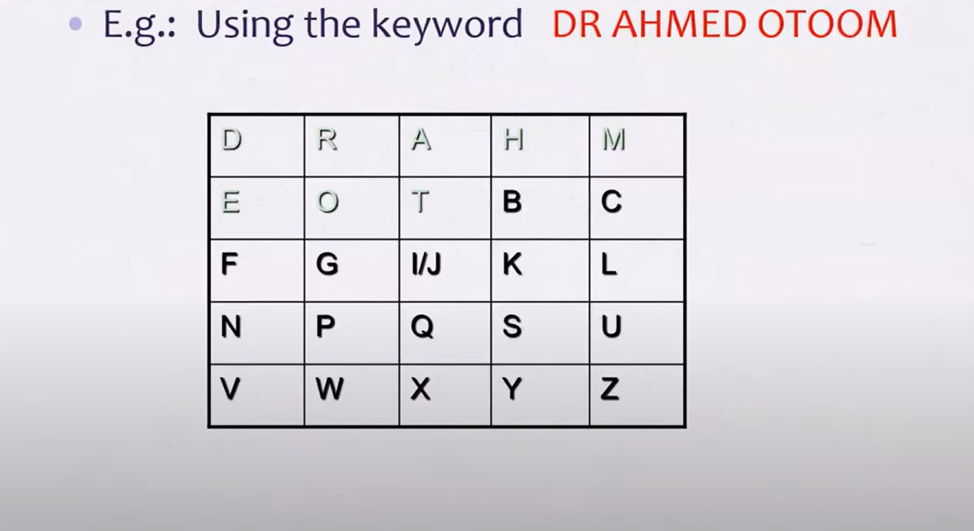

Slide 10
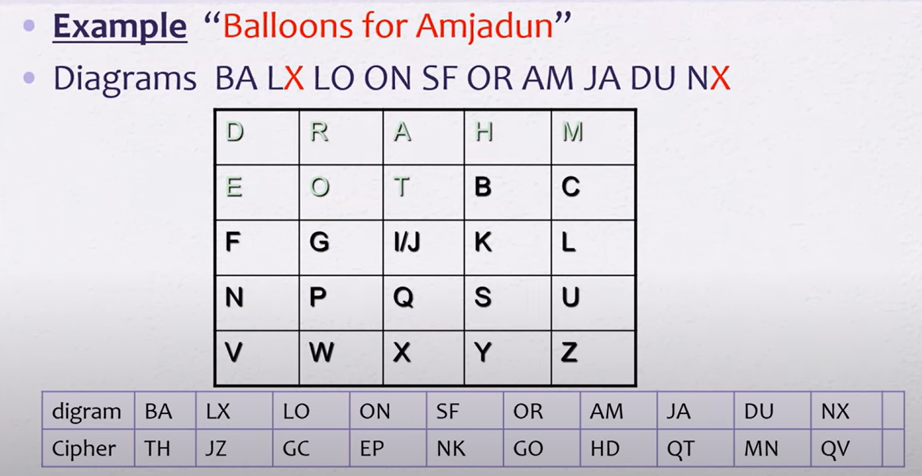

Slide 11
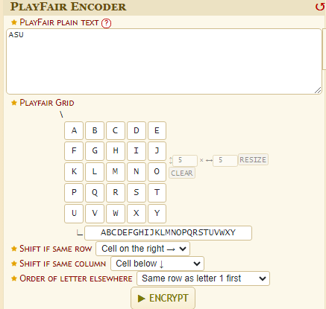
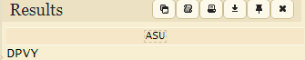
Polygraphic Ciphers
Playfair Cipher:

Slide 12
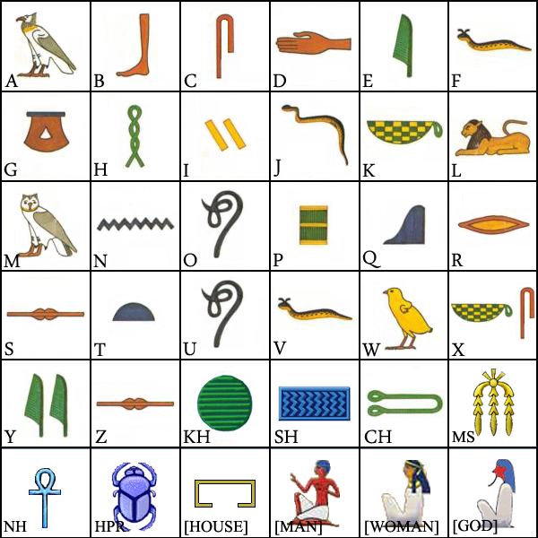
Hieroglyphics and Steganography
Hieroglyphics and Steganography: Ancient Egyptians used hieroglyphics to hide messages in clear plain by using symbols and imagery. Steganography involved hiding messages within other media, such as writing a message in invisible ink on a paper that seems just a message.

Slide 13
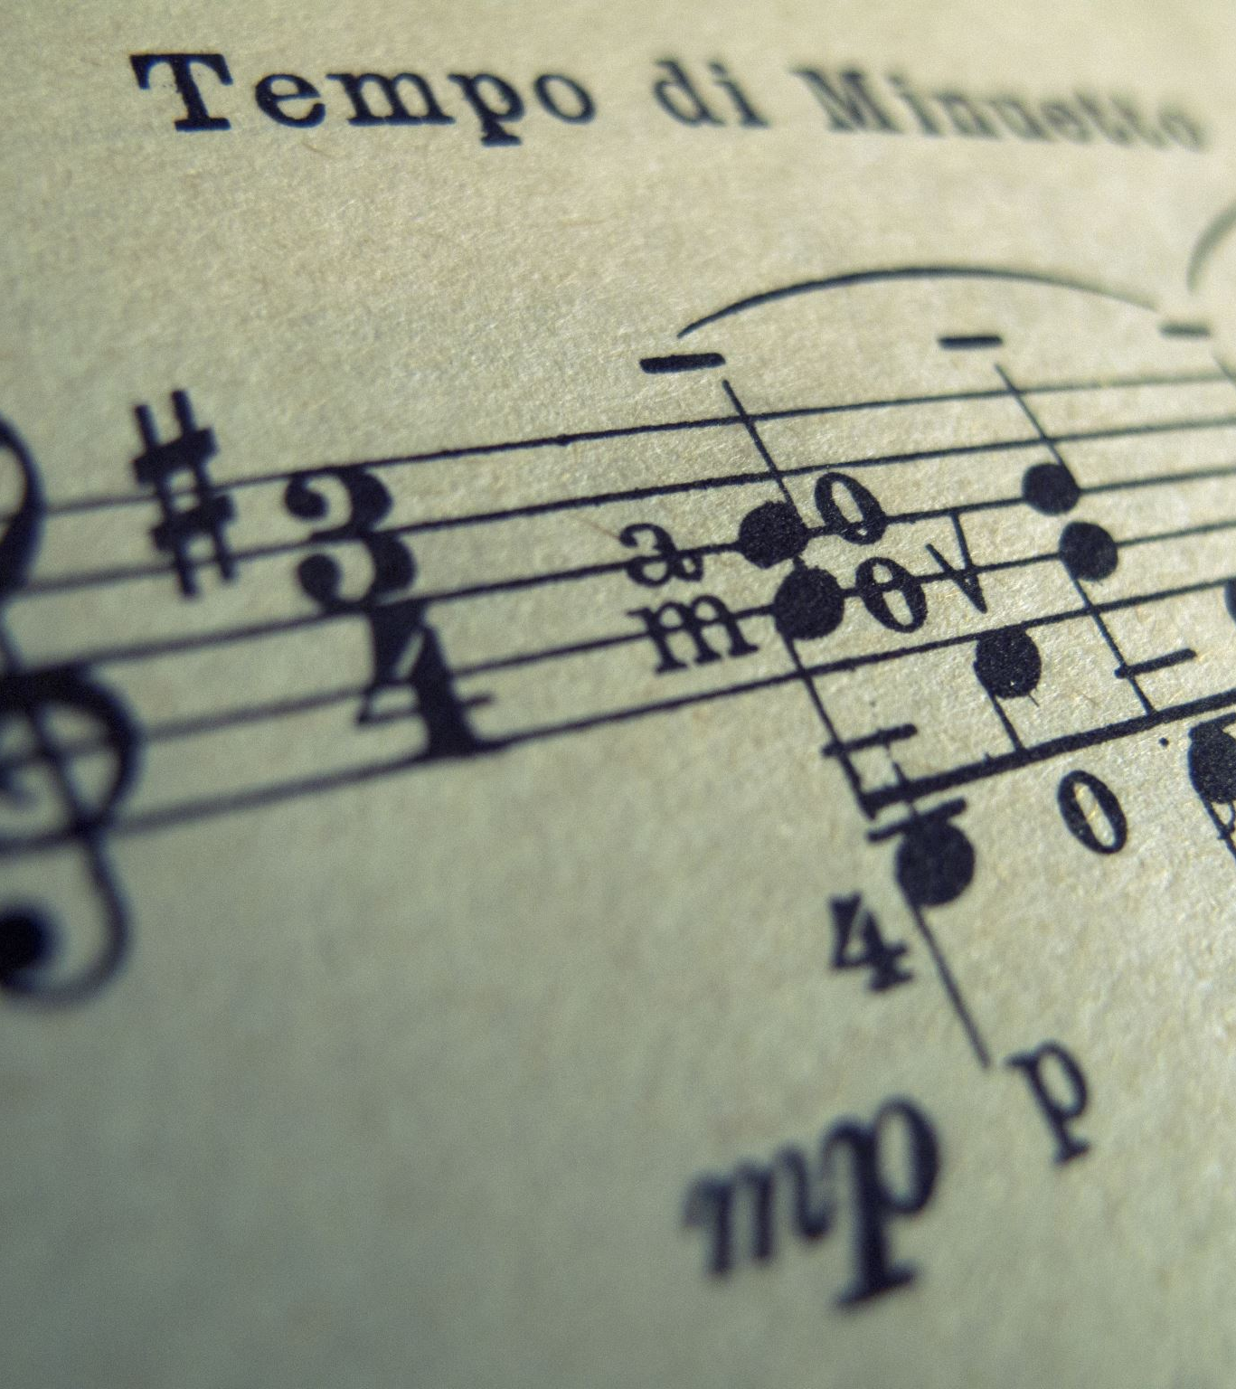
Audio Decoder .wav/.mp3
Ok! Now we can decode the Morse Code Cipher. But what if the Morse Code come as mp3 audio file how to decode that Morse Code.
You have two ways to do that the hard way and the simple way :
Hard way is to listen to that audio and try to decoded from a morse code table.
And the easy way is to upload the mp3 file on that website to analyze it and convert it from audio morse code to text morse code then to alphabet.
https://morsecode.world/international/decoder/audio-decoder-adaptive.html
------------------------------------------------------------------
https://academo.org/demos/spectrum-analyzer/

Slide 14

Other Ciphers
JSFuck Cipher
ASCII : ASU
JSFuck : [][(![]+[])[+[]]+(![]+[])[!+[]+!+[]]+(![]+[])[+!+[]]+(!![]+[])[+[]]][([][(![]+[])[+[]]+(![]+[])[!+[]+!+[]]+(![]+[])[+!+[]]+(!![]+[])[+[]]]+[])[!+[]+!+[]+!+[]]+(!![]+[][(![]+[])[+[]]+(![]+[])[!+[]+!+[]]+(![]+[])[+!+[]]+(!![]+[])[+[]]])
Encode:
https://www.53lu.com/tool/jsfuck/
Decode:
https://www.53lu.com/tool/jsfuckdecode/

Slide 15

Other Ciphers
Brainfuck Cipher
ASCII : ASU
Brainfuck : ++++++++++[>+>+++>+++++++>++++++++++<<<<-]>>>-----.>-----------------.++.
https://www.dcode.fr/brainfuck-language

Slide 16

Other Ciphers
Ook! Cipher
ASCII : ASU
Ook! : Ook. Ook. Ook. Ook. Ook. Ook. Ook. Ook. Ook. Ook. Ook. Ook. Ook. Ook. Ook. Ook. Ook. Ook. Ook. Ook. Ook! Ook? Ook. Ook? Ook. Ook. Ook. Ook? Ook. Ook. Ook. Ook. Ook. Ook. Ook. Ook? Ook. Ook. Ook. Ook. Ook. Ook. Ook. Ook. Ook. Ook. Ook. Ook. Ook. Ook. Ook. Ook? Ook. Ook. Ook. Ook. Ook. Ook. Ook. Ook. Ook. Ook. Ook. Ook. Ook. Ook. Ook. Ook. Ook. Ook. Ook. Ook. Ook? Ook. Ook? Ook. Ook? Ook. Ook? Ook. Ook! Ook! Ook? Ook! Ook. Ook? Ook. Ook? Ook. Ook? Ook! Ook! Ook! Ook! Ook! Ook! Ook! Ook! Ook! Ook! Ook! Ook. Ook. Ook? Ook! Ook! Ook! Ook! Ook! Ook! Ook! Ook! Ook! Ook! Ook! Ook! Ook! Ook! Ook! Ook! Ook! Ook! Ook! Ook! Ook! Ook! Ook! Ook! Ook! Ook! Ook! Ook! Ook! Ook! Ook! Ook! Ook! Ook! Ook! Ook. Ook. Ook. Ook. Ook. Ook! Ook.
https://www.dcode.fr/ook-language

Slide 17
Tools
Encoding and Numeric Base Conversions:
https://simplycalc.com/index.php
https://www.rapidtables.com/convert/number/ascii-hex-bin-dec-converter.html
CyberChef
Text manipulation, processing, ciphers and encoding:
https://gchq.github.io/CyberChef/
dCode
Cipher identification:
https://www.dcode.fr/cipher-identifier
This random website that I found in highschool
Encryption/Decryption goldmine:
http://rumkin.com/tools/cipher/
dCode
Another encryption/decryption goldmine:
https://www.dcode.fr/tools-list#cryptography
Practical Cryptography
Practical Cryptography has resources for learning to break classical ciphers (as opposed to just decrypting the message!)
http://practicalcryptography.com/ciphers/

